Slide 1


Slide 2
INTRODUCTION
A database is an organized collection of data that is stored and accessed electronically. The primary purpose of a database is to store, manage, and retrieve data efficiently and securely. Data storage is crucial for any organization, as it allows for the systematic storage of large amounts of information, such as customer details, sales transactions, inventory levels, and employee records. By storing data in a database, organizations can ensure that their information is easily accessible, searchable, and can be analyzed to gain insights and make informed decisions.
EXAMPLES : SQL like MySQL, oracle
NoSQL like MongoDB, Cassendra

Slide 3
What is SQL?
SQL (Structured Query Language) is the language used to interact with relational databases, which store data in a structured way using tables, similar to how we use Excel spreadsheets.
In these databases, data is organized in rows and columns. Each table represents a different type of data, and the structure (schema) of the table is fixed.
Examples of SQL Databases: MySQL, PostgreSQL, Oracle, and SQL Server. These are some popular databases that use SQL.

Slide 4
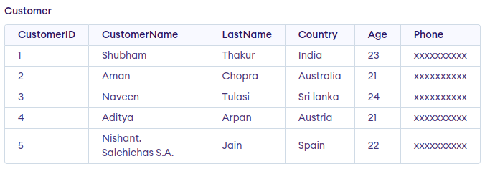
An Example

Slide 5
Drawbacks of SQL
Scalability Issues: SQL databases are good for small to medium-sized applications, but they struggle with scaling up to handle very large amounts of data because it's hard to split them across multiple servers.
Rigid Schema: Once you set up the structure (schema) of an SQL database, it’s difficult to change. If you want to add new types of data or change the format, it can be a complex and time-consuming process.
Handling Unstructured Data: SQL databases are not designed to handle unstructured data like social media posts, images, or complex nested data (e.g., JSON documents).
Performance: As the amount of data grows, complex queries (like those involving multiple tables or "joins") can slow down the performance of SQL databases.

Slide 6
What is NoSQL?
NoSQL stands for "Not Only SQL." It refers to a group of databases that are designed to store and retrieve data in ways other than the traditional tables used in SQL databases.
Need of NoSQL Databases:
High Scalability
Efficient big data management
Partition tolerance
Fast development
High availability

Slide 7
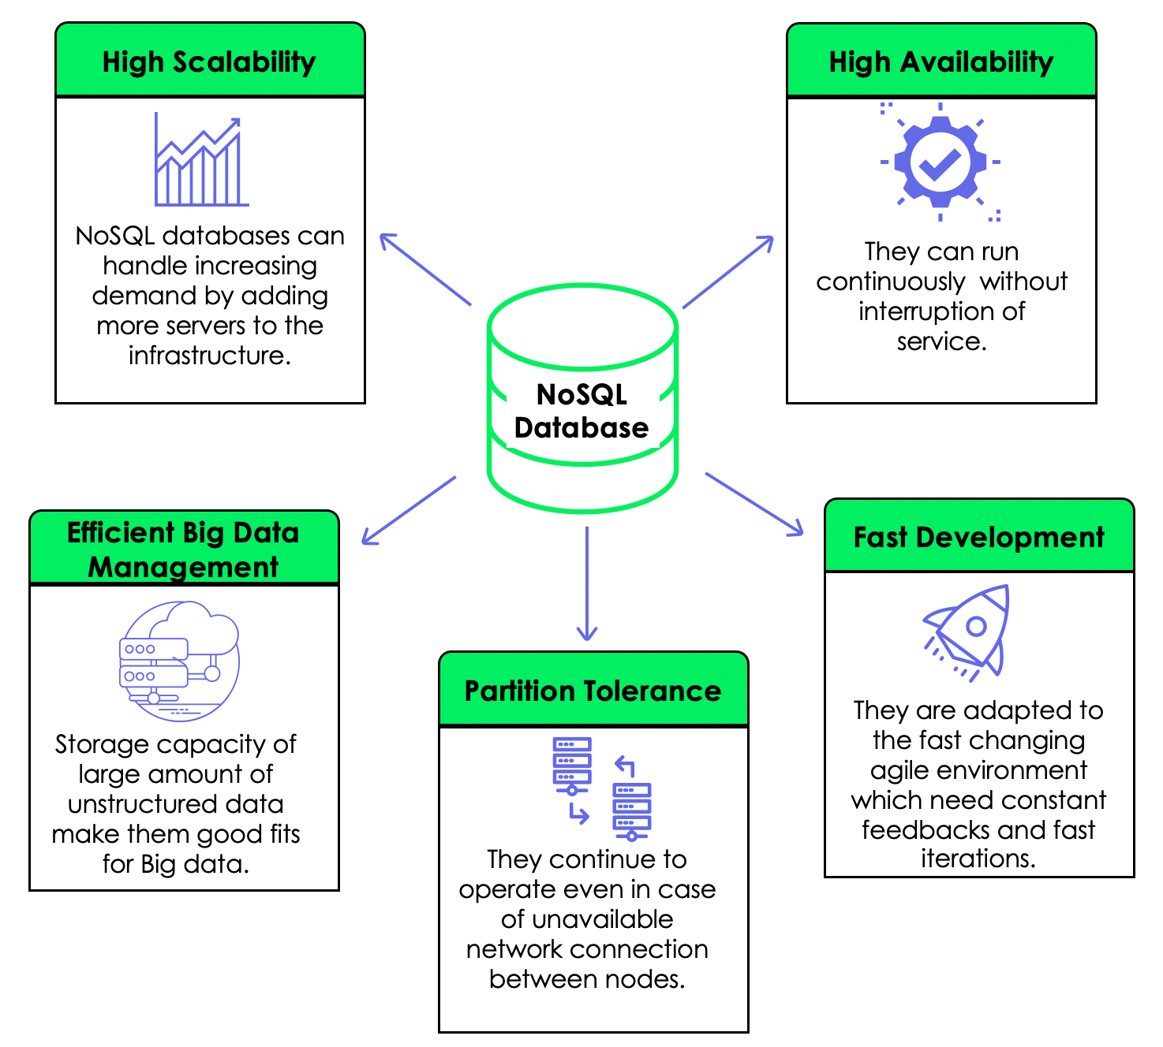

Slide 8
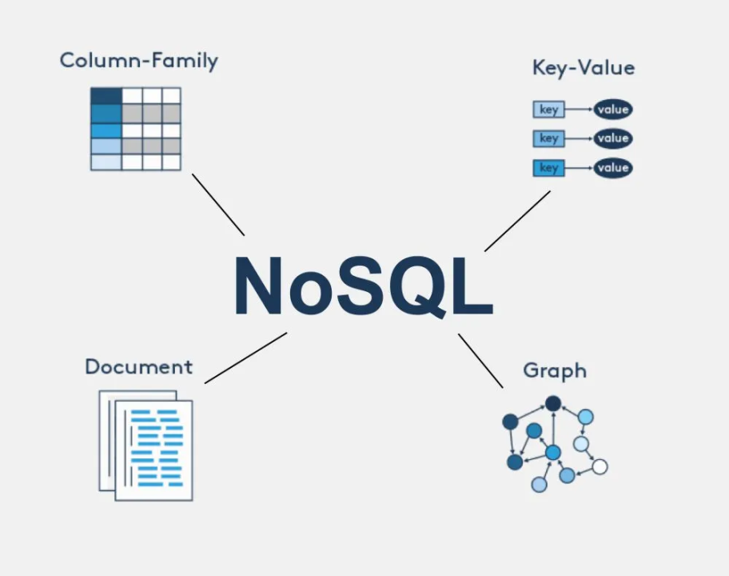
Types of NOSQL

Slide 9
Types of NoSQL
Key-Value Stores: Store data as a collection of key-value pairs, similar to a dictionary in Python or a hash map in Java. Example: Redis.
Column-Family Stores: Store data in columns instead of rows, allowing for very fast reads and writes. Example: Cassandra.
Graph Databases: Store data as nodes and edges, making them ideal for analyzing relationships in social networks or organizational charts. Example: Neo4j.
Document-Oriented Databases: Store data in documents (like JSON) that are flexible and can vary in structure. Example: MongoDB.

Slide 10
Introduction to MongoDB
What is MongoDB?
MongoDB is a popular NoSQL database that stores data in a format similar to JSON (a lightweight data-interchange format).
Key Features:
Schema-less: It does not require a predefined schema, making it flexible for storing different types of data.
Stores data in BSON format: BSON is similar to JSON but is designed to be more efficient and performant.
High performance and scalability: MongoDB is designed to handle a large amount of data and can easily be scaled horizontally by adding more servers.

Slide 11
Applications
MongoDB, a leading NoSQL database, is widely used across various industries due to its flexibility, scalability, and performance. Here are some key applications of MongoDB:
1.Content Management Systems (CMS)
2. E-commerce Platforms
3. Real-Time Analytics
4. Internet of Things (IoT)
5. Gaming Applications
6. Mobile Applications
7. Social Media Platforms
8. Customer Data Management

Slide 12
Conclusion
SQL databases are great for structured data and small to medium-sized applications, but NoSQL databases like MongoDB offer better flexibility, scalability, and performance for modern applications with diverse and large datasets.

Slide 13
Thank You...

